Slide 1

Java Programming For Beginners
Course 1
محمد إبراهيم الدسوقى
محاضر بكلية هندسة و علوم الحاسب – قسم نظم المعلومات
جامعة الأمير سطام بن عبد العزيز - السعودية – محافظة الخرج
Email : mohamed_eldesouki@hotmail.com

Slide 2
Java Programming For Beginners
Course 1
What is programming ?

Slide 3
What Is Programming and Program Development Life Cycle ?
Programming is a process of problem solving
Step 1: Analyze the problem
  Understand the Overall problem
  Define problem requirements
    Does program require user interaction?
      If yes , What Is the Input ?
    What is the Expected output?
  Design steps (algorithm) to solve the problem
Processing
Input
Output
Algorithm:
  Step-by-step problem-solving process

Slide 4
What Is Programming and Program Development Life Cycle ?
Step 2: Implement the algorithm
  Implement the algorithm in code
  Verify that the algorithm works
Step 3: Maintenance
  Use and modify the program if the problem domain changes
If the problem is complex, divide it into sub-problems
  Analyze each sub-problem as above

Slide 5
Example
Write a program to find the Area of a rectangle
The area of the Rectangle are given by the following formula:
Area = Rect Length * Rect Width.
Input :
        Rectangle Length , Rectangle Width.
Processing :
        Area = Rect Length * Rect Width.
Output :
          Print Out The area.

Slide 6


To sum It up…….
Then
Think
Write Code

Slide 7

See you Next Video

Slide 8
Java Programming For Beginners
Course 1
How to Install Java ?

Slide 9
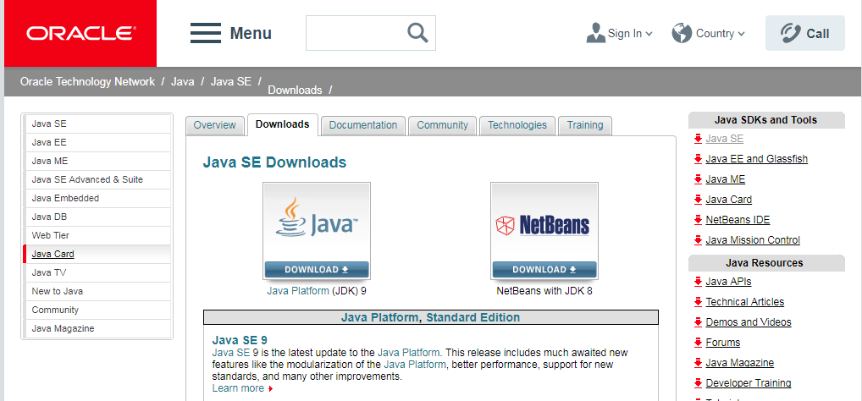
http://www.oracle.com/technetwork/java/javase/downloads/index.html

Slide 10
See you Next Video

Slide 11
Java Programming For Beginners
Course 1
Your First java Program

Slide 12
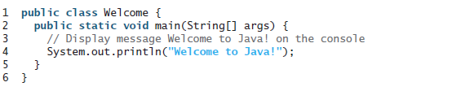
Your First Java Program

Slide 13
Processing a Java Program

Slide 14

Programming Errors
Syntax Errors
  Detected by the compiler
Runtime Errors
  Causes the program to abort
Logic Errors
  Produces incorrect result

Slide 15
Comments
We can put comment on our programs using
// to comment a single line
    // this progrm is written by mohamed El desouki
/*
  Mulitple Lines
*/ to comment multiple lines
    /* This program is written by Mohamed El Desouki
    On Monday 11/1/2018
    */

Slide 16
Java Programming For Beginners
Course 1
Display Program Output

Slide 17
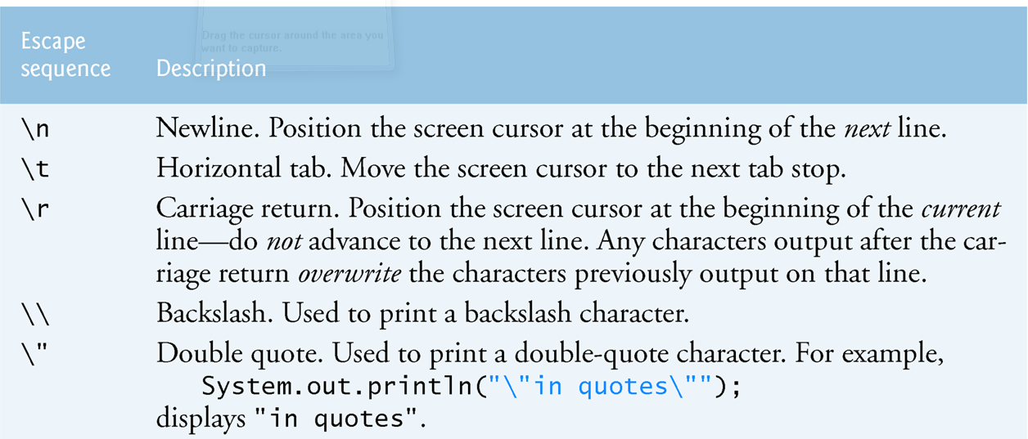
Interacting With User: Displaying Messages on Screen
In Java, we use System.out.print ( ) Or System.out.println () To be Display text on The screen

Slide 18
Interacting With User: Displaying Messages on Screen
He said that “Iam From Egypt” but lives in “KSA”
  System.out.print(“ He Said That \“Iam From Egypt \” but lives in \“KSA\” “)
The Files located in D:\javaprorg\tryoutput
  System.out.print(“The Files located in D:\\javaprorg\\tryoutput “)
Sunday Monday Tuesday Wednesday Thursday
  System.out.print(“Sunday \t Monday \t Tuesday \t Wednesday\t Thursday“)

Slide 19
See you Next Video

Slide 20
Java Programming For Beginners
Course 1
Accepting Input From User
Part 2

Slide 21
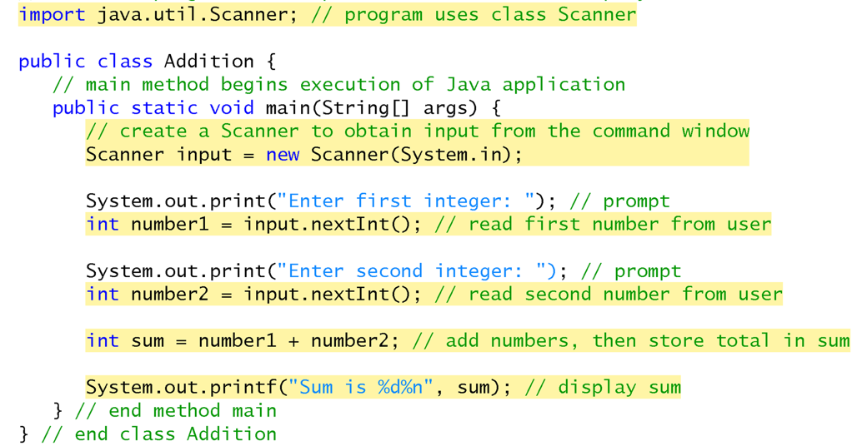
Java Programming For Beginners
Course 1
Receiving Input From User

Slide 22
Java Data Types
char | Character or small integer. | 1byte | signed: -128 to 127 unsigned: 0 to 255
int | Integer. | 4bytes | signed: -2147483648 to 2147483647 unsigned: 0 to 4294967295
short int (short) | Short Integer. | 2bytes | signed: -32768 to 32767 unsigned: 0 to 65535
long int (long) | Long integer. | 4bytes | signed: -2147483648 to 2147483647 unsigned: 0 to 4294967295
bool | Boolean value. It can take one of two values: true or false. | 1byte | true or false
float | Floating point number. | 4bytes | +/- 3.4e +/- 38 (~7 digits)
double | Double precision floating point number. | 8bytes | +/- 1.7e +/- 308 (~15 digits)
long double | Long double precision floating point number. | 8bytes | +/- 1.7e +/- 308 (~15 digits)

Slide 23
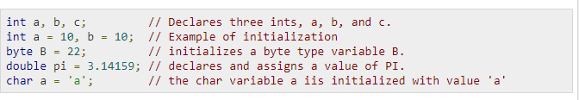
Interacting With User: Accept Input From User
A variable is a location in the computer’s memory where a value can be stored for use by a program.
All variables must be declared with a name and a data type before they can be used in a program.
Declaration : DataType Identifier

Slide 24
Example 1
Write a program to find the Area of a rectangle
The area of the Rectangle are given by the following formula:
Area = Rect Length * Rect Width.
Input :
        Rectangle Length , Rectangle Width.
Processing :
        Area = Rect Length * Rect Width.
Output :
          Print Out The area.

Slide 25
Working With Variable
Int length ;
Int width;
Int area;
Scanner input = new Scanner(System.in);
Length = input.nextInt();
Width = input.nextInt();
Area = Length * width ;
Length
5
Width
10
area
50

Slide 26
Example 2
Write a program to find the perimeter and area of a square
The perimeter and area of the square are given by the following formulas:
perimeter = Side Length * 4
area = Side Length * Side Length
Input:
        Square Side Length
Processing:
        perimeter = Side Length * 4
        area = Side Length * Side Length
  Output:
        Print Out The Perimeter and Area.

Slide 27
See you Next Video

Slide 28
Java Programming For Beginners
Course 1
Arithmetic Operators – Part 2

Slide 29
Arithmetic Operations

Slide 30
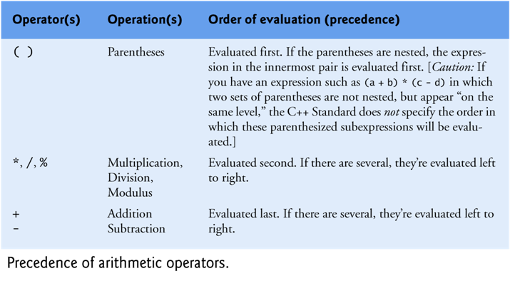
Precedence of arithmetic operations
For example, 2 + 3 * 5 and (2 + 3) * 5
both have different meanings

Slide 31
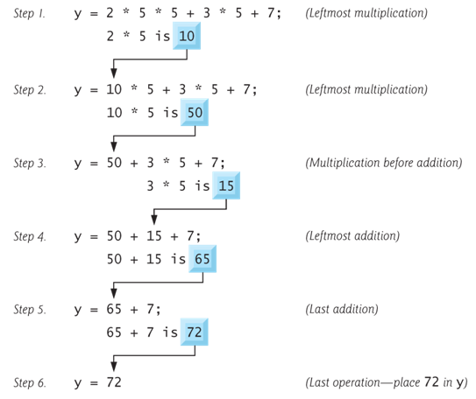
Precedence of arithmetic operations
Example :

Slide 32
Precedence of arithmetic operations
? = 1 + 2 * (3 + 4)
  Evaluated as 1 + (2 * (3+4)) and the result is 15
? = 5 * 2 + 9 % 4
  Evaluated as (5*2) + (9 % 4) and the result is 11
? = 5 * 2 % ( 7 – 4)
  Evaluated as (5 * 2) % (7 – 4) and the result is 1

Slide 33
Data Type of an Arithmetic Expression
Data type of an expression depends on the type of its operands
  Data type conversion is done by the compiler
If operators are *, /, +, or – , then the type of the result will be:
  integer, if all operands are integer.
        Int A , B;
        A+ B → Integer.
  float, If at least one operand is float and there is no double
        Int A ; Float B;
        A + B → Float.
  double, if at least one operand is double
    Int A ; Float B; Double C;
        A + B + C → double.

Slide 34
Increment and Decrement Operators
Increment operator: increment variable by 1
  Pre-increment: ++variable
  Post-increment: variable++
Decrement operator: decrement variable by 1
  Pre-decrement: --variable
  Post-decrement: variable --
  Examples :
      ++K , K++ → k= K+1
      --K , K-- → K= K-1

Slide 35
Increment and Decrement Operators
If the value produced by ++ or – – is not used in an expression, it does not matter whether it is a pre or a post increment (or decrement).
When ++ (or – –) is used before the variable name, the computer first increments (or decrements) the value of the variable and then uses its new value to evaluate the expression.
When ++ (or – –) is used after the variable name, the computer uses the current value of the variable to evaluate the expression, and then it increments (or decrements) the value of the variable.
There is a difference between the following
x = 5;
Print(++x);
x = 5;
Print (x++);

Slide 36
special assignment statements
Java has special assignment statements called compound assignments
  += , -= , *= , /= , %=
Example:
X +=5 ; means x = x + 5;
x *=10; means x = x * 10;
x /=5; means x = x / 5;

Slide 37
See you Next Video

Slide 38
Java Programming For Beginners
Course 1
Selection - IF Statement

Slide 39
Control Statements
Normally, statements in a program are executed one after the other in the order in which they’re written.
This is called sequential execution.
There are control statements enable you to specify that the next statement to be executed may be other than the next one in sequence.
This is called transfer of control.
The control statements are categorized in almost two groups:
    Selection control statements
    Repetition control statements

Slide 40
Sequential Execution
Transfer of Control
1
2
3
4
5
6
7
8
9

Slide 41
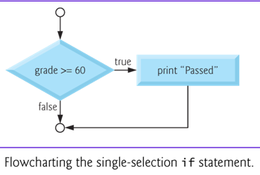
Selection Statements : If Statement
Selection statements are used to choose among alternative courses of action.
For example, suppose the passing mark on an exam is 60. The pseudocode statement
  If student’s marks is greater than or equal to 60 Then
  Print “Passed”

Slide 42
In Java, The syntax for the If statement
if ( Expression)
action statement ;
The Expression can be any valid expression including a relational expression and even arithmetic expression
In case of using arithmetic expressions , a non-zero value is considered to be true, whereas a 0 is considered to be false
if ( Expression)
{
action statement 1 ;
action statement 2 ;
.
.
action statement n ;
}
if ( grade >= 60 )
System.out.println (“Passed”);

Slide 43
Relational Expression and Relational Operators
Relational expression is an expression which compares 2 operands and returns a TRUE or FALSE answer.
Example : a >= b , a == c , a >= 99 , ‘A’ > ‘a’
Relational expressions are used to test the conditions in selection, and looping statements.
Operator | Means
== | Equal To
!= | Not Equal To
< | Less Than
<= | Less Than or Equal To
> | Greater Than
>= | Greater Than or Equal To

Slide 44
Selection Statements : If Statement
Example : write a program that accept an integer from the user and in case this integer is even print out the following message
    “This number is even “ .

Slide 45
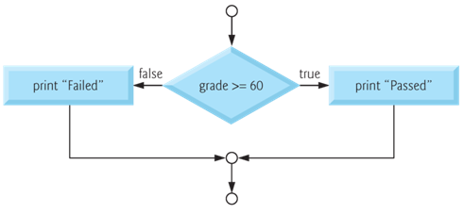
Selection Statements : If .. Else Statement
The IF…Else selection statement allows you to specify that there is a course of actions are to be performed when the condition is true and another course of actions will be executed when the condition is false.
For example, the pseudocode statement
  If student’s mark is greater than or equal to 60
  Print “Passed”
  else
  Print “Failed”

Slide 46
In Java, The syntax for the If…Else statement
if ( Expression)
action statement ;
Else
action statement ;
if ( Expression)
{
action statements 1 ;
.
action statement n ;
}
Else
{
action statements 1 ;
.
action statement n ;
}
if ( grade >= 60 )
System.out.println("Passed“);
Else
System.out.println(“Failed“);

Slide 47
Selection Statements : If – else Statement
Example : write a program that accept an integer from the user and
print out whether it is Positive or Negative number.

Slide 48
Java Programming For Beginners
Course 1
Selection - IF Statement

Slide 49
Nested If
Nested If : means to write an if statement within another if statement.
Example : write a program that accept an integer number from the user ,
in case the number is Positive , check and print out whether it is Even or Odd number.
int main()
{
int number;
System.out.println("Please Enter any number “) ;
Number = input.nextInt();
if ( number >=0)
  if (number % 2 == 0)
  System.out.println(" This is an Even number “);
  else
  System.out.println("This is an Odd number“);
}

Slide 50
IF – Else IF statement
For example, write a program that ask the user to Enter 2 numbers and print out whether they are equal or there is one which is greater than the other.
  main()
  {
    int num1, num2;
    System.out.println("Enter Number 1 , Number2 “);
    Num1= input.nextInt();
    Num2= input.nextInt();
    if ( num1 == num2 )
    System.out.println ("Both Are Equal “);
    else if (num1 > num2 )
    System.out.println("Number 1 is greater than number 2 “);
    else
    System.out.println ("Number 2 is greater than number 1 “);
  }

Slide 51
IF – Else IF
For example, the following code will print
  A for exam grades greater than or equal to 90,
  B for grades greater than or equal to 80,
  C for grades greater than or equal to 70,
  D for grades greater than or equal to 60, and
  F for all other grades.
  if ( grade >= 90 )
  System.out.println( "A“) ;
  else if ( grade >= 80 )
  System.out.println( "B”);
  else if ( grade >= 70 )
  System.out.println("C”);
  else if ( grade >= 60 )
  System.out.println("D”);
  else
  System.out.println("F“) ;

Slide 52
Combining more than one condition
To combine more than one condition we use the logical operators.
Operator | Means | Description
&& | And | The Expression Value Is true If and Only IF both Conditions are true
|| | OR | The Expression Value Is true If one Condition Is True
Example : check whether num1 is between 0 and 100
IF ( num1 >= 0 && num1 <=100 )
System.out.println (“The Number Is between 1 and 100”) ;
Else
System.out.println( “ The Number Is Larger Than 100”);

Slide 53
Combining more than one condition
Example, print out the student grade according to the following formulas:
  A for exam marks greater than or equal 90 and less than or equal 100 ,
  B for exam marks greater than or equal 80 and less than 90 ,
  C for exam marks than or equal to 70 and less than 80 ,
  D for exam marks than or equal to 60, and less than 70 ,
  F for all other marks.
  if ( marks >= 90 && marks <= 100)
  System.out.println ( "A“ );
  else if (marks >= 80 && marks <90 )
  System.out.println ( "B”);
  else if (marks >= 70 && marks <80 )
  System.out.println ( "C”);
  else if (marks >= 60 && marks <70 )
  System.out.println ( "D”);
  else
  System.out.println ( "F\n“) ;

Slide 54
Example : A company insures its Employees in the following cases:
  Employee is married.
  Employee is an Single male above 30 years of age.
  Employee is an Single female above 25 years of age.
  Conditions :
    Marital status = ‘M’; OR
    Marital Status =‘S’ and Sex=‘M’ and Age >30 OR
    Marital Status =‘S’ and Sex=‘F’ and Age >25

Slide 55
See you Next Video

Slide 56
Java Programming For Beginners
Course 1
Selection – Switch Statement
Part 2

Slide 57
Selection statements: Switch Statement.
The switch control statement allows us to make a decision from the number of choices
Switch (Expression )
{
case constant 1 :
Action statements;
break ;
case constant 2 :
Action statements;
break ;
case constant 3 :
Action statements;
break ;
default :
Action statements;
}
Expression It could be an integer constant like 1, 2 or 3, or an expression that evaluates to an integer .
Constant : is a specific value.
Switch (10.0);
float i ;
Switch (i);
switch ( i + j * k )
switch ( 23 + 45 % 4 * k )
Switch (10);
Int i ;
Switch (i);
switch ( 23 + 45 % 4 * k )
Case >= 50;
Case a+ b;

Slide 58
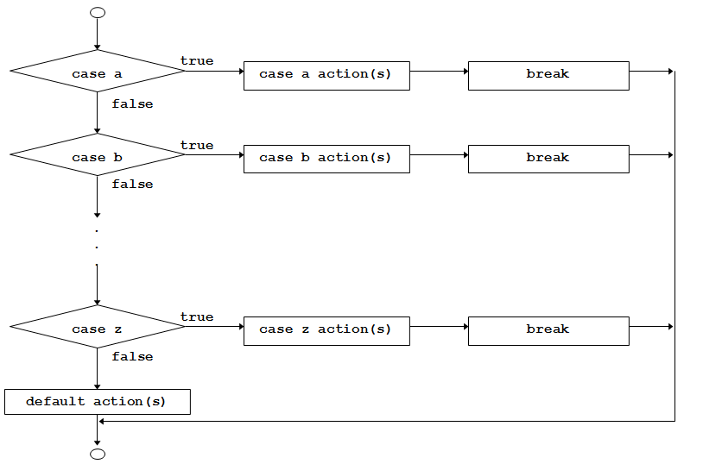

Slide 59
1. The switch Statement
1
2
3
4
5
6
7
8
9
10
11
12
13
14
15
16
17
18
19
20
21
22
23
24
25
26
public static void main (String[] args)
{
//Declaration section
Scanner read = new Scanner (System.in);
char grade;
String message;
//input section
grade = read.next().charAt(0);
//processing section
switch (grade)
{
case ‘A’: message = “Excellent”;
break;
case ‘B’: message = “Very Good”;
break;
case ‘C’: message = “Good”;
break;
case ‘D’: message = “Fair”;
break;
case ‘F’: message = “Failed”;
break;
default: message =“The grade is invalid”;
} //end switch
//output section
System.out.println (message);
} //end main
if (grade == ‘A’)
message = “Excellent”;
Else if (grade == ‘B’)
message = “Very Good”;
else if (grade == ‘C’)
message = “Good”;
else if (grade == ‘D’)
message = “Fair”;
else if (grade == ‘F’)
message = “Fail”;
else message = “The grade is invalid”;
System.out.println (message);

Slide 60
Write a program that displays the following menu, then acts accordingly:
Enter your choice:
Add two numbers
Get the Subtract of two number
Get the square of a number
The program should give an error message for invalid inputs.

Slide 61
public static void main (String[] args)
{
Scanner read = new Scanner (System.in);
int choice, num1, num2, result = -1;
String message = “Invalid input”;
System.out.println (“Enter your choice:”);
System.out.println (“1. Add two numbers”);
System.out.println (“2. Get the double of a positive number”);
System.out.println (“3. Get the square of a number”);
choice = read.nextInt();
//processing section
switch (choice)
{
case 1: System.out.println (“Enter two positive integers”); //prompt
num1 = read.nextInt();
num2 = read.nextInt();
result = num1 + num2; // the value of result is no more equal to -1
break;
case 2: System.out.println (“Enter a positive integer”); //prompt
num1 = read.nextInt();
num2 = read.nextInt();
result = num1 – num2;
break;
case 3: System.out.println (“Enter an integer”); //prompt
num1 = read.nextInt();
result = num1 * num1; // the value of result is no more equal to -1
break;
default: message =“Invalid value of choice”; //no change to “result” ➔ result=-1
} //end switch

Slide 62
When the same action is to be taken for several case labels, then we may write the program as follows:
public static void main (String[] args)
{
//Declaration section
Scanner read = new Scanner (System.in);
char letter;
String vowel = “This is a vowel”;
//input section
letter = read.next().charAt(0);
//processing section
switch (letter)
{
case ‘a’:
case ‘e’:
case ‘o’:
case ‘i’:
case ‘u’: System.out.println (vowel);
break;
default: System.out.println (“This is not a vowel”);
} //end switch
} //end main
This is equivalent to:
if (letter==‘a’) || (letter==‘e’) || (letter==‘o’) || (letter==‘i’) || (letter==‘u’)
System.out.println (vowel);

Slide 63
switch vs. nested if
The switch statement is an elegant way to apply multiple selections. It is less confusing.
However, the programmer is forced sometimes to use the nested if. Examples of such cases include:
  If the selection involves a range of values.
    Example: if (score >= 60) && (score < 70)
  If the selector’s type is double or float.
    Example: if (salary == 5000.25)

Slide 64
See you Next Video

Slide 65
Java Programming For Beginners
Course 1
Repeation – While Loop

Slide 66
Control Statements : Repetition statements
Some times we need to repeat a specific course of actions either a specified number of times or until a particular condition is being satisfied.
For example :
  To calculate the Average grade for 10 students ,
  To calculate the bonus for 10 employees or
  To sum the input numbers from the user as long as he/she enters positive numbers.
There are three methods by way of which we can repeat a part of a program. They are:
  (a) Using a while statement
  (b) Using a do-while statement
  (C) Using a for statement

Slide 67
Opening Problem
Problem:
System.out.println("Welcome to Java!");
System.out.println("Welcome to Java!");
System.out.println("Welcome to Java!");
System.out.println("Welcome to Java!");
System.out.println("Welcome to Java!");
System.out.println("Welcome to Java!");
…
…
…
System.out.println("Welcome to Java!");
System.out.println("Welcome to Java!");
System.out.println("Welcome to Java!");
int count = 0;
while (count < 100) {
System.out.println("Welcome to Java");
count++;
}
100 times

Slide 68
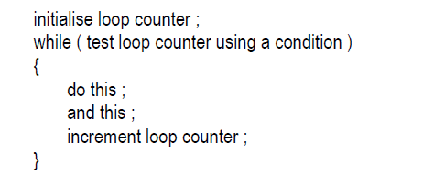
1- The While Loop
While ( continuation condition)
{
Action statement 1 ;
Action statement 2 ;
.
.
Action statement n ;
}
1- loop counter is any numeric variable ( int , float ,….).
2- when using a counter , the while loop is called counter–controlled loop.
3- The initial value of the loop counter is up to you,
but you have to increment it to avoid endless loops.

Slide 69
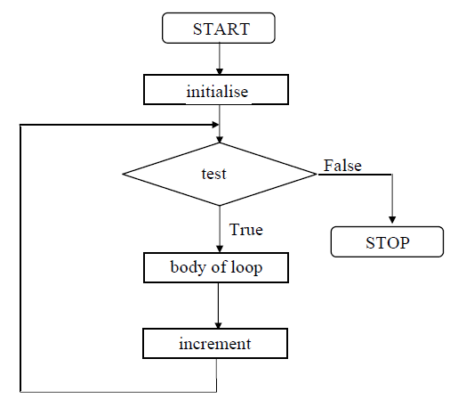
The condition being tested may be relational, logical or even numeric expression :
while ( i <= 10 )
while ( i >= 10 && j <= 15 )
While (3) , While (3 + 5)

Slide 70
  Example : Write a program that calculates and prints out the Average grade for 6 students .
  int counter = 1;
  int grade=0 , sum=0;
  while (counter <=6)
  {
  System.out.printf(" Enter grade for student no %d" , counter);
  grade = input.nextInt( );
  sum += grade;
  counter ++;
  }
  System.out.printf(" Average Grade is %f“ , sum/counter );

Slide 71
  Example : Write a program that calculates and prints out the Average grade for 5 students or ends the program by entering -1.
  int grade=0, counter =1, sum=0;
  System.out.println(" Enter 5 grades or -1 To Exit “);
  while (counter <=5 && grade !=-1)
  {
  grade = input.nextInt( );
  sum += grade;
  counter ++;
  }
  System.out.printf(" The sum of grades is %d“,sum);

Slide 72
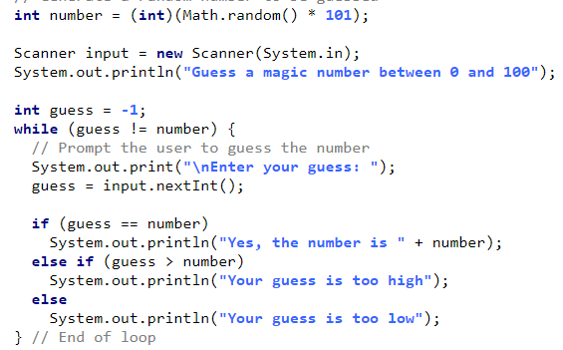
Write a program that randomly generates an integer between 0 and 100, inclusive. The program prompts the user to enter a number continuously until the number matches the randomly generated number. For each user input, the program tells the user whether the input is too low or too high, so the user can choose the next input intelligently. Here is a sample run:

Slide 73
See you Next Video

Slide 74
Java Programming For Beginners
Course 1
Repeation – do..while Loop

Slide 75
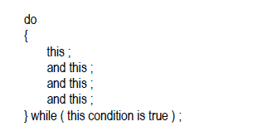
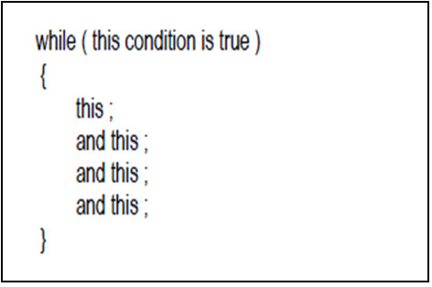
2- The do-while Loop

Slide 76
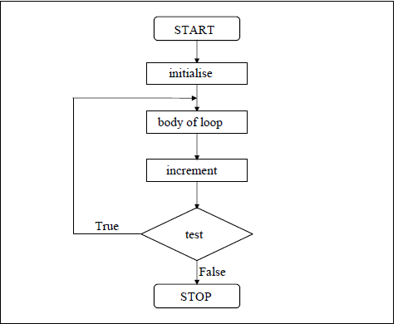
2- The do-while Loop
The condition being tested may be relational, logical or even numeric expression :
while ( i <= 10 )
while ( i >= 10 && j <= 15 )
While (3) , While (3 + 5)

Slide 77
2- The do-While Loop
  Example : Write a program that calculates and prints out the Average grade for 6 students .
  int counter = 1;
  int grade=0 , sum=0;
  do
  {
  System.out.println("Enter grade for student no “+ counter);
  Grade= input.nextInt( );
  sum += grade;
  counter ++;
  }
  while (counter <=6) ;
  System.out.println(" Average Grade is “ + sum/counter );

Slide 78
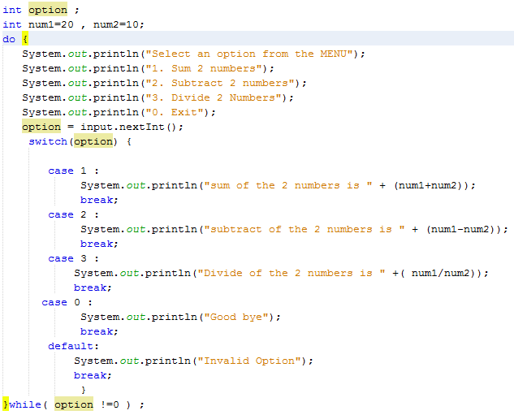

Slide 79
See you Next Video

Slide 80
Java Programming For Beginners
Course 1
Repeation – For Loop

Slide 81
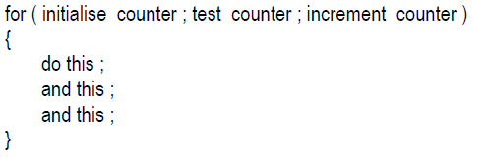
3- The For Loop.
For Loop is probably the most popular looping instruction.
general form of for statement is
The for allows us to specify three things about a loop in a single line:
  (a) Setting a loop counter to an initial value.
  (b) testing the loop counter to detect whether its value reached the number of repetitions desired.
  (c) increasing the value of loop counter each time the program segment
  within the loop has been executed.

Slide 82
3- The For Loop.
  Example : Write a program that calculates and prints out the Average grade for 6 students .
int grade=0, sum=0;
for (int counter =1 ; counter <=6 ; counter ++)
{
System.out.println("Enter Grade “);
Grade = input.nextInt();
sum += grade;
}
System.out.println ("The Average grades is “ +( sum/6));
int counter = 1;
int grade=0 , sum=0;
while (counter <=6)
{
System.out.println("Enter grade”) ;
grade = Input.nextInt( );
sum += grade;
counter ++;
}
System.out.println ("Average Grade is “ + (sum/6 );

Slide 83
3- The For Loop.
  Example : Write a program that prints out numbers from 0 to 10;
  for (int i= 0 ; i <=10 ; i++)
  System.out.println ( i );
  Example : Write a program that prints out numbers from 0 to 10 in descending order;
  for (int i = 10 ; i >=0 ; i-- )
  System.out.println ( i);
  Example : Write a program that prints out the even numbers from 2 to 20;
  for (int i = 2 ; i <=20 ; i+=2 )
  System.out.println (i);

Slide 84
3- The For Loop.
  Example : Write a program that accepts 10 numbers from the user and prints out the sum of even numbers and the sum of odd numbers.

Slide 85
int i = 1 ;
for ( ; i <= 10 ; i + + )
  System.out.println ( i);
int i ;
for ( i = 0 ; i++ < 10 ; )
  System.out.println ( i);
int i = 1 ;
for ( ; i <= 10 ; )
{
  System.out.println ( i);
i ++;
}
int i ;
for ( i = 0 ; ++ i < 10 ; )
  System.out.println ( i);

Slide 86
3- The For Loop.
  Example : Write a program that calculates the Factorial for any given positive number.
  Ex : Factorial (5) = 5 * 4 * 3 * 2 * 1
int number, factorial=1;
System.out.println ( "Enter a positive number“);
Number = input.nextInt();
if (number < 0 )
System.out.println ( " Enter Positive Numbers only“) ;
else
for (int i= 1 ; i <=number ; i++)
factorial = factorial * i;
System.out.println ( " Factorial = “ + factorial);

Slide 87
Nested Loops
  Example : Write a program that calculates the Factorial for numbers from 1 to 10;
for ( int number=1; number<=10 ; number++)
{
  for ( int i= 1 ; i <=number ; i++)
  {
  factorial = factorial * i ;
  }
System.out.println ( " Factorial = “ + factorial);
}

Slide 88
See you Next Video

Slide 89
Java Programming For Beginners
Course 1
Repeation – Break & continue Statements

Slide 90
THE break STATEMENT
The break statement is typically used To exit early from a loop (for, while, do…while)
After the break statement, the remaining of the statements inside the loop are skipped. Then, execution continues starting at the first statement after the loop.
1
2
3
4
5
6
7
8
9
10
11
12
13
Int num=0, counter = -1, sum = 0; //initialize the accumulator sum
while (counter <=5) //num is used as a sentinel
{
System.out.println (“Enter a positive integer”); //prompt
num = read.nextInt();
if (num < 0)
{
System.out.println (“Negative numbers are not allowed”);
break;
} //end if
sum =sum + num;
Counter ++;
} // end while
System.out.println (“Sum = “ + sum);

Slide 91
THE continue STATEMENT
The continue statement may be used in all loop statements (for, while, do…while)
The continue statement skips the remaining statements inside the loop; and proceeds with the next iteration, if any.
1
2
3
4
5
6
7
8
9
10
11
12
13
Int num=0, counter = -1, sum = 0; //initialize the accumulator sum
while (counter <=5) //num is used as a sentinel
{
System.out.println (“Enter a positive integer”); //prompt
num = read.nextInt();
if (num < 0)
{
System.out.println (“Negative numbers are not allowed”);
continue;
} //end if
sum =sum + num;
Counter ++;
} // end while
System.out.println (“Sum = “ + sum);

Slide 92
See you Next Video

Slide 93
Java Programming For Beginners
Course 1
Revision on
Conditional and loop statements

Slide 94
2. ANALYSIS
INPUT & OUTPUT
Saudi Airlines permit each passenger to hold one bag. The maximum weight allowed for the bag depends on the class of the passenger which is: 30 Kg for First class ('F'), 25 Kg for Business ('B') and 20 Kg for Economy ('E'). If the weight of the bag excesses the allowed one, the passenger should pay 10 SR for each Kg.
Write a program that calculates the excess baggage charge for the passenger. All input data should be read by the user. Solve the problem using the switch statement.
?
Charge depends on?
Passenger Class | PassClass (Given) | Allowed Weight (Given)
First Class | ‘F’ | 30 Kg
Business Class | ‘B’ | 25 Kg
Econonmy Class | ‘E’ | 20 Kg

Slide 95
2. ANALYSIS
INPUT
  For a specific passenger, we want to know:
  Passenger’s Class
  ➔ Entered by the user.
  Baggage Weight
  ➔ Entered by the user.
OUTPUT
  Charge to excess weight:
    Excess weight = Actual Weight – Allowed Weight (depending on his class)
    Charge = Excess Weight * 10 SR

Slide 96
5. CODE (1)
1
2
3
4
5
6
7
8
9
10
11
12
13
14
15
16
17
18
19
20
21
22
23
// import necessary libraries
import java.util.*;
public class passenger
{
// instantiate Scanner object
static Scanner read = new Scanner(System.in);
public static void main (String[] args)
{
// Declaration section
char passClass; // passenger’s class
double bagWeight; // passenger’s bag weight
double excessWeight = 0.0;// passenger’s excess weight
double charge = -1.0; // charge on excess weight
// Input section
System.out.print (“Please enter passenger’s class”);
passClass = read.next().charAt(0); // read passenger’s class
System.out.print (“Please enter passenger’s baggage weight”);
bagWeight = read.nextDouble(); // read baggage weight
// Processing section: charge depends on passClass
switch (passClass)
{
case ‘F’: excessWeight = bagWeight – 30;
break;

Slide 97
5. CODE (2)
19
20
21
22
23
24
25
26
27
28
29
30
31
32
33
// Processing section: charge depends on passClass
switch (passClass)
{
case ‘F’: if (bagWeight > 30)
excessWeight = bagWeight – 30;
break;
case ‘B’: if (bagWeight > 25)
excessWeight = bagWeight – 25;
break;
case ‘E’: if (bagWeight > 20)
excessWeight = bagWeight – 20;
break;
} //end switch
charge = excessWeight * 10;
// Output Section
System.out.printf (“Charge = %5f”, charge);
} //end main
} //end class

Slide 98
5. CODE (3)
WITH USER INPUT VALIDATION
19
20
21
22
23
24
25
26
27
28
29
30
31
32
33
34
35
36
37
38
39
40
// Processing section: charge depends on passClass
switch (passClass)
{
case ‘f’:
case ‘F’: if (bagWeight > 30) {excessWeight = bagWeight – 30;
charge = excessWeight * 10;}
break;
case ‘b’:
case ‘B’: if (bagWeight > 25) {excessWeight = bagWeight – 25;
charge = excessWeight * 10;}
break;
case ‘e’:
case ‘E’: if (bagWeight > 20) {excessWeight = bagWeight – 20;
charge = excessWeight * 10;}
break;
default: System.out.println (“Invalid passenger class”);
} //end switch
// Output Section
if (charge != -1) // if the initial value of charge is overwritten
System.out.printf (“Charge = %5f”, charge);
} //end main
} //end class

Slide 99
See you Next Video

Slide 100
Java Programming For Beginners
Course 1
Functions (Methods) – Part 1

Slide 101
Functions - Methods
Most computer programs that solve real-world problems include hundreds and even thousands of lines.
Experience has shown that the best way to develop and maintain a large program is to construct it from smaller pieces or modules, each of which is more manageable than the original program.
A Function : is a self-contained block of statements that perform a specific task.
Using a function is something like hiring a person to do a specific job for you.

Slide 102

In Real Life
In Programming
Task 4
Task 1
Function ( )
Function ( )
Task 3
Task 2
Function ( )
Function ( )

Slide 103
Why to use Functions ?
Functions allows to write more manageable units of code.
Writing functions avoids rewriting the same code over and over.
Easy maintenance for programs.
Important Tips
1- Don’t try to cram the entire logic in one function. It is a very bad style of programming.
2- Instead, break a program into small units and write functions for each of these isolated subdivisions.
3- Don’t hesitate to write functions that are called only once.

Slide 104
Calculate and print out The sum and the Average of 3 student marks.
Task 4
Task 1
Print_out ( )
Get_Marks( )
Task 3
Task 2
Calc_sum( )
Calc_Average ( )

Slide 105
Functions
Function Definition
    return-value-type function-name( parameter-list )
    {
    Lines of code to be
    executed
    …
    (Body)
    }
return-value- Type:
Is the data type for the returned value from the function to the calling program. It is Mandatory, if no returned value expected , we use keyword Void.
Parameter-List : Is a list of data values supplied from the calling program as input to the function. It is Optional
2- Invoking Function ( From The main( ) )
Function name ( Actual Parameter- List );

Slide 106
Function Types
Built in Functions (Ready Made).
    For Example : Math Functions Like
int abs (int number) ;
double pow (double base, double exponent) ;
Double floor (double number);
Double sqrt (double number);

Slide 107
Java Programming For Beginners
Course 1
Functions (Methods) – Part 2

Slide 108
User-Defined Functions
Value-returning functions: have a return type
  Return a value of a specific data type using the return statement
  the returned value can be used in one of the following scenarios:
    Save the value for further calculation
      Int result;
      Result = sum ( x , y );
    Use the value in some calculation
      Result = sum(x , y) /2;
    Print the value
      System.out.println (sum(x , y) ) ;
Void functions: do not have a return type
  Do not use a return statement to return a value

Slide 109
public class methodOneParameter
{
public static void main(String[] args)
{
System.out.println (“Start of Program”); //output line #1
drawLine(); //method calling
Sysetm.out.println(“Welcome to the First lecture in Functions”);
drawLine(); //method calling
System.out.println (“End of Program”);
} //end of main
//method definition: This method draws a line
public static void drawLine( )
{
int i;
for (i=0; i < 10; i++)
System.out.print (‘*’);
System.out.println();
} //end of drawLine
} //end of class

Slide 110
public class methodOneParameter
{
public static void main(String[] args)
{
System.out.println (“Start of Program”); //output line #1
drawLine(‘*’); //method calling
Sysetm.out.println(“Welcome to the First lecture in Functions”);
drawLine(‘#’); //method calling
System.out.println (“End of Program”);
} //end of main
//method definition: This method draws a line
public static void drawLine( char ch)
{
int i;
for (i=0; i < 10; i++)
System.out.print (ch);
System.out.println();
} //end of drawLine
} //end of class

Slide 111
public class methodOneParameter
{
public static void main(String[] args)
{
System.out.println (“Start of Program”); //output line #1
drawLine(‘*’,15); //method calling
Sysetm.out.println(“Welcome to the First lecture in Functions”);
drawLine(‘#’,20); //method calling
System.out.println (“End of Program”);
} //end of main
//method definition: This method draws a line
public static void drawLine(char ch , integer length )
{
int i;
for (i=0; i < length; i++)
System.out.print (ch);
System.out.println();
} //end of drawLine
} //end of class

Slide 112
See you Next Video

Slide 113
Java Programming For Beginners
Course 1
Functions (Methods) – Part 3

Slide 114
For Example : write a program that ask the user to Enter 3 integer numbers and print out their sum and Average.
int main ()
{
int n1 , n2 , n3 ;
System.out.println("Please Enter 3 integer numbers “ );
n1= input.nextInt();
n2= input.nextInt();
n3= input.nextInt();
System.out.println(" The sum of the 3 number is “ || sum (n1, n2,n3) );
System.out.println(" The average of the 3 number is " || average (n1, n2,n3) );
}
Public static int sum (int num1 , int num2, int num3)
{
return num1+num2+num3;
}
Public static double average (int num1, int num2, int num3 )
{
return sum (num1 , num2 , num3)/3 ;
}

Slide 115
Scope of a variable
scope is the context within a program in which a variable is valid and can be used.
  Local variable: declared within a function (or block)
  can be accessible only within the function or from declaration to the end of the block.
  Within nested blocks if no variable with same name exists.
int sum (int x , int y )
{
int result ;
result = x + y;
return result;
}
int main ( )
{
{
Int x ;
}
}
Local
Local

Slide 116
Scope of a variable
  Global variable: declared outside of every function definition.
  Can be accessed from any function that has no local variables with the same name. In case the function has a local variable with the same name as the global variable ,
static Int z ;
int main ( )
{
{
}
}
int sum (int x , int y )
{
}
Global

Slide 117
Scope of a variable
Static int x = 100 ;
int main ( )
{
int x= 10;
    {
      int z , x ;
      z=100;
      y=100;
      x= 250;
      System.out.println(" inner block " << x ;
    }
}
Global
Local
Local

Slide 118
See you Next Video

Slide 119
Java Programming For Beginners
Course 1
Functions (Methods) – Part 4

Slide 120
Method Overloading
Method Overloading:
  Defining several methods within a class with the same name. As long as every Method has a different signature
Method Signature:
  The signature of a method consists of the following:
  Method name
  Formal parameter list
Note that the method type is not part of its signature.
Examples:
  public int Sum(int x, int y)
  public int Sum(int x, int y , int z)
  public double Sum(double x, double y, double z)
  public int Sum(int x, double y)
  public int Sum(double y, int x)

Slide 121
The following methods are incorrectly overloaded; the compiler generates an error:
Example (1): The following methods are incorrectly overloaded because they have the same method name and same formal parameter lists:
  public void methodABC (int x, double y)
  public int methodABC (int x, double y)
Example (2): Changing the names of the formal parameters, does not allow overloading of the previous counter-example:
  public void methodABC (int x, double y)
  public int methodABC (int num1, double num2)
Counter-example (3): Adding the modifier static does not allow overloading of the previous example:
  public static void methodABC (int x, double y)
  public int methodABC (int num1, double num2)
Note that the method type and modifiers are not part of the overloading rules

Slide 122
See you Next Video

Slide 123
Java Programming For Beginners
Course 1
One Dimensional Arrays – Part 1

Slide 124
ARRAY DECLARATION
SYNTAX
dataType[ ] arrayName = new datatype [intExp];
In Java, an array is an object that must be instantiated using the new operator.
arrayName is the reference variable.
dataType is the data type of the array; which is the same type of all elements in the array.
intExp is any expression that evaluates to a positive int type.
intExp represents the size of the array: this is the number of elements in the array.

Slide 125
ARRAY DECLARATION
EXAMPLES
Consider the following array declaration:
int[] num = new int [5];
From the above statement:
  num is the array name
  num consists of 5 elements
  The type of the elements is int
Address | Value
num → | 0
 | 0
 | 0
 | 0
 | 0
Index
0
1
2
3
4
The memory layout will be as follows:
As shown, the array name points to the first element in the array.
The five elements of the array are adjacent in the memory.

Slide 126
ARRAY DECLARATION
USING CONSTANTS AS SIZES
final int ARRAY_SIZE = 5;
int[] num = new int [ARRAY_SIZE];
double[ ] num = new double[ARRAY_SIZE];
char[ ] x = new char[ARRAY_SIZE];
boolean[ ] flags = new boolean[ARRAY_SIZE];
The size of the array must be of type int.

Slide 127
ARRAY DECLARATION
USING EXPRESSIONS AS SIZES
final int ARRAY_SIZE = 5;
int[] num = new int[ARRAY_SIZE*5];
The expression may be in terms of an int variable rather than a constant:
int i = 8;
int[] num = new int[i*2-1];

Slide 128
ARRAY DECLARATION
SPECIFYING SIZES DURING EXECUTION
It is not necessary to know the size of the array at compile time.
During program execution, the user may be prompted to enter the size of the array. The object (array) is then instantiated using this value.
Consider the following example:
Scanner read = new Scanner(System.in);
int arraySize;
System.out.println (“Enter the size of the array ”);
arraySize = read.nextInt();
int[ ] list = new int [arraySize];

Slide 129
ARRAY Initialization
INITIALIZATION WITH DECLARATION
An array can also be initialized with specific values when it is declared:
Double [ ] sales = {12.25, 24.2, 32.55, 50.33};
When initializing arrays during declaration, the size of the array is determined by the number of initial values in the initializer list within the braces.
When instantiating an array object, the initial values depend on the array type:
  For numeric types (int, double, etc…) the elements take the value zero by default.
  For char type, the elements take the value null character (‘’).
  For boolean type, the elements take the value false.

Slide 130


Arrays
Accessing array Elements
      Arrayname [element index].
Example: int [] list = new list[10];
list[5] = 34;
System.out.println( list [5]);

Slide 131
Example : Write a program that ask the user to enter 10 Employee salaries and store them , then add a bonus of 10 % for each employee and print out the average salary value.

Slide 132
Example - Write a program that finds the sum and the average of positive integers stored in an array of integers.

Slide 133
See you Next Video

Slide 134
Java Programming For Beginners
Course 1
One Dimensional Arrays – Part 2
Passing Arrays as a method Parameters

Slide 135
Passing Array as a parameter to a method
To pass an array argument to a method, specify the name of the array without any brackets.
For example, if array ids is declared as
int [] ids = new int[50];
then the method call search ( ids , 100 );
passes the reference of array salaries to method search.
public static int search (int[] list, int target)
{
int index;
for (index = 0; index < list.length; index++)
if (list[index] == target);
return index;
return -1;
} //end search
Main()
{
Int [ ] employee_ids = new int[10];
Int position = Search(imployee_ids , 30);
}

Slide 136
Passing Array as a parameter to a method
public static void fillArray(double[ ] list)
{
for (int i=0; i<list.length; i++)
{
System.out.println (“Enter next element: “);
list[i] = read.nextDouble();
} //end for
} //end fillArray
public static void main(String[] args)
{
double[] sales = new double[100];
fillArray (sales);
printArray (sales);
}
public static void printArray(double[] list)
{
int i;
for (i=0; i < list.length; i++)
System.out.print (list[i] + “ “);
System.out.println();
} //end of printArray

Slide 137
See you Next Video

Slide 138
Java Programming For Beginners
Course 1
Two Dimensional Arrays

Slide 139
Two Dimensional Arrays
One-dimensional arrays are suitable for data provided in a list form.
Student_IDs
100 | 120 | 135 | 145 | 190 | 210
Two-dimensional arrays are suitable for data provided in a table form.
 | CS1301 | CS1111 | PHY1040 | CE1111
Fahd | A | A+ | B | B-
Ahmed | A+ | A- | C | B+
Faisal | C+ | D | A- | D+
For the above example, you need to know:
  The number of rows in the table (3 in the example)
  The number of columns in the table (4 in the example)
Also, in order to access an array element, you need to know:
  The element lies in which row and in which column
For example, Fahd grade in CE1111 lies in the intersection of the first row with the fourth column.

Slide 140
DECLARATION
SYNTAX
dataType[][] arrayName = new dataType[rows][cols];
rows : indicates the number of rows.
cols: indicates the number of columns.
The following example declares a two-dimensional array marks of 4 rows and 6 columns:
double[][] marks = new double[4][6];

Slide 141
ACCESSING ARRAY ELEMENTS
SYNTAX
arrayName[Row][Col]
1
2
3
4
sales[0][0] = 15.0;
sales[1][2] = 12.0;
sales[2][1] = 21.0;
 | sales[][0] | sales[][1] | sales[][2] | sales[][3] | sales[][4]
sales[0][] | 15.0 | sales[0][1] | sales[0][2] | sales[0][3] | sales[0][4]
sales[1][] | sales[1][0] | sales[1][1] | 12.0 | sales[1][3] | sales[1][4]
sales[2][] | sales[2][0] | 21.0 | sales[2][2] | 430.0 | sales[2][4]
sales[3][] | sales[3][0] | sales[3][1] | sales[3][2] | sales[3][3] | sales[3][4]

Slide 142
length
Consider the following code segment:
Int [ ][ ] matrix = new int[20][15];
System.out.printf (“Number of rows = %d”, matrix.length);
System.out.printf (“Number of columns = %d”, matrix[0].length);
arrayName.length gives the number of rows.
`gives the number of columns.
Output
Number of rows = 20
Number of columns = 15

Slide 143
INITIALIZATION
The two-dimensional array may be initialized as follows:
//Initialize and declare
int[ ][ ] array2 = { {2, 1, 3}, {3, 5, 2}, {4, 2, 2}};
The above example may be depicted as follows:
2
1
3
3
5
2
4
2
2

Slide 144
Let us initialize the elements of row #2 to 7:
int col;
for (col = 0; col < matrix[2].length; col++)
matrix[2][col] = 7;
When processing a row using a loop, the condition is “the number of columns”, which is matrix[2].length in this example.
The number of the row is fixed, and the number of the column varies from 0 to matrix[2].length ➔ col is the loop counter.
Let us initialize the elements of col #1 to 5:
int row;
for (row = 0; row < matrix.length; row++)
matrix[row][1] = 5;

Slide 145
Example : Write a program that build a matrix of 5 rows and 3 columns . Ask the use to enter the values for all the matrix items , print out the sum of all matrix items.

Slide 146
See you Next Video

Slide 147
Two dimensional Array as a Parameter to Function
when declaring a two-dimensional array as a formal parameter, you can omit the size of the first dimension, but not the second;
that is, you must specify the number of columns.
void printMatrix( int matrix[ ][4], int Rows)
{
int row, col;
for (row = 0; row < Rows ; row++)
{
for (col = 0; col < 4; col++)
System.out.println( setw(5) << matrix [row] [col] ;
}
System.out.println(“\n” ;
}

